Slide 2
Predicting APS failure at Scania truck
Team name : The Technocrats
Group members:
Md. Masudur Rahman (1631189042)
Saraf Sumaita Hasan (1631258042)
Md Rifat Hasan (1620259042)
Rehnuma Sharmin (1620739042)

Slide 3
Dataset explanation
Problem Discussion
Data preprocessing
Model Implementation
Result Analysis
Summary
Table of Contents

Slide 4
Dataset Explanation
Collected from the Industrial Challenge for IDA 2016
Collected from heavy Scania trucks in everyday usage.
Contains a training and test set
Consists of a subset of all available data, selected by experts
Attribute names have been anonymized for proprietary reasons
Consists of both single numerical counters and histograms consisting of bins with different conditions
Subset of all available data, selected by experts

Slide 5
Dataset Explanation
Characteristics : Multivariate
Attribute Characteristics: Integer, Real
Associated Task: Classification
Training dataset :
Number of Features : 171
Records : 60,000
Features : Anonymized
Type : Labeled
Testing dataset :
Number of Features : 171
Records : 16000
Features : Anonymized
Type : Labeled

Slide 6
Problem Discussion
The system in focus is the Air Pressure system (APS) which generates pressurized air that are utilized in various functions in a truck, such as braking and gear changes.
Classification problem (2 classes – Positive and Negative)
The positive class consists of component failures for a specific component of the APS system.
The negative class consists of trucks with failures for components not related to the APS.

Slide 7
Problem Discussion
Our main task is to find that the failure is APS related or not
And
Thus to find the misclassification and the penalty for having these misclassification and to minimize them
Failure –
Type 1 failure – False Positive (Penalty of 10)
Type 2 failure – False Negative (Penalty of 500)
Total cost = 10 * No of instances of Type 1 Failure + 500 * No of instances of Type 2 Failure

Slide 8
Challenges
High quantity of missing values
High imbalance in the class distribution

Slide 9
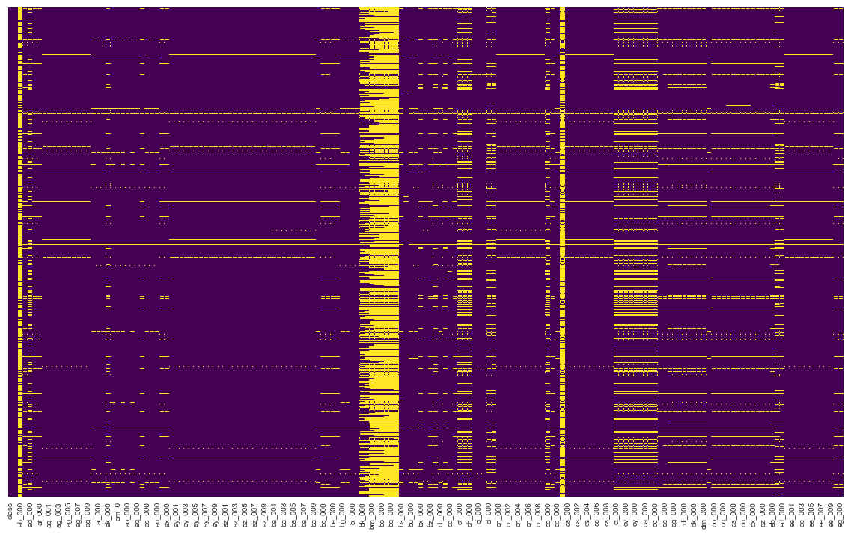
Data Preprocessing
Heatmap for Missing Values’ Representation
This graph representing missing values over the full dataset in yellow line

Slide 10
Data Preprocessing
For handling the missing values –
Discard the columns having more than 80% missing values
Replace all the missing values with their corresponding mean

Slide 11
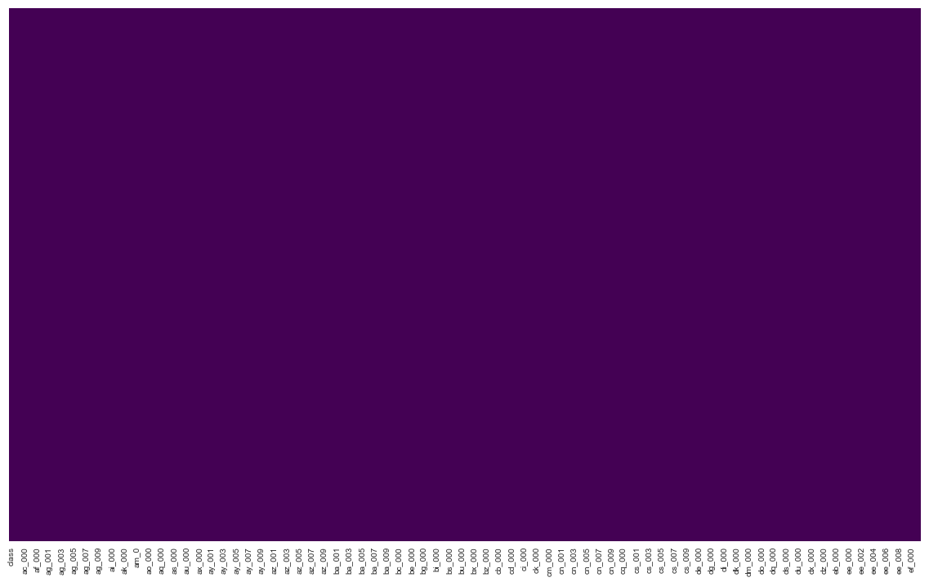
Data Preprocessing
After replacing all the missing values with their corresponding mean values ,
Heatmap for Missing Values’ Representation

Slide 12
Data Preprocessing
What will happen to the response class ?
Dummy variables ?
class | aa_000 | ab_000 | ac_000 | ad_000 | ae_000 | af_000 | ag_000 | ag_001 | ag_002
0 | 76698 | 0.713189 | 2.13E+09 | 280 | 0 | 0 | 0 | 0 | 0
0 | 33058 | 0.713189 | 0 | 190620.64 | 0 | 0 | 0 | 0 | 0
0 | 41040 | 0.713789 | 228 | 100 | 0 | 0 | 0 | 0 | 0
0 | 12 | 0.000000 | 70 | 66 | 0 | 10 | 0 | 0 | 0
0 | 60874 | 0.713189 | 1368 | 458 | 0 | 0 | 0 | 0 | 0
Sample data representation

Slide 13
Model Implementation
Implemented model : Logistic regression
Dividing this section into 3 subsection –
Cross Validation
Threshold tuning
Predicting using the testing data

Slide 14
Cross Validation
For the cross validation, we have evaluated –
5 Fold
10 Fold
Of these, 10 fold CV gives us the better result, we are going to discuss the evaluation more briefly in the Result analysis section

Slide 15
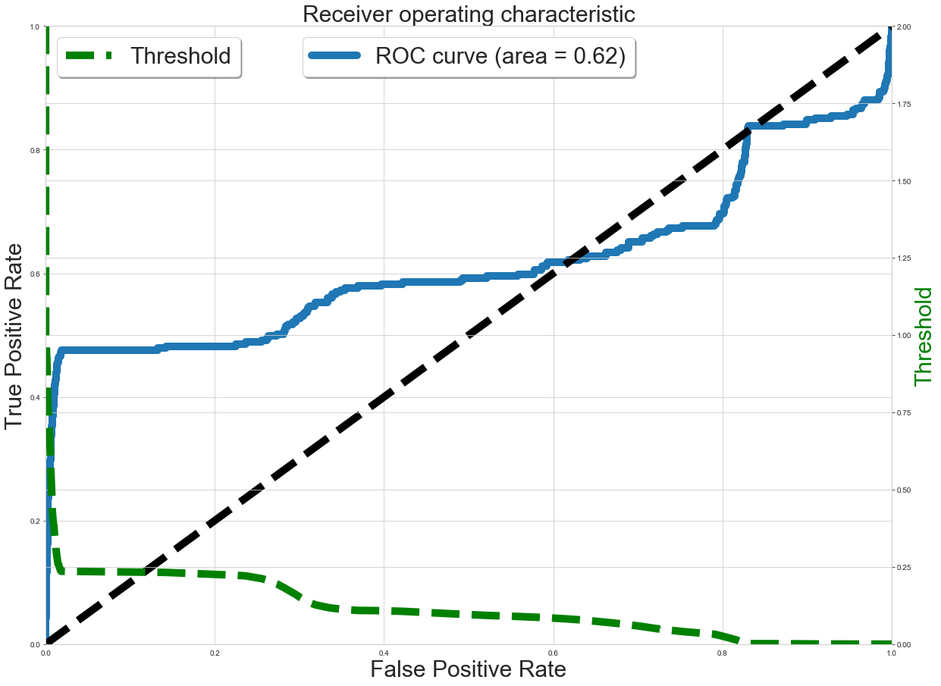
Threshold Tuning
We are going to find the optimal threshold by using the ROC_AUC curve
0.253~0.250

Slide 16
Model Implementation
Our testing data is untouched till now
After the cross validation and threshold tuning,
We are now going to implement our fitted logistic regression model for the prediction using the Test Data
We will discuss the result the next segment

Slide 17
Result Analysis
Cross validation

Slide 18
Result Analysis

Slide 19
Result Analysis
Test data implementation and outcome analysis

Slide 20
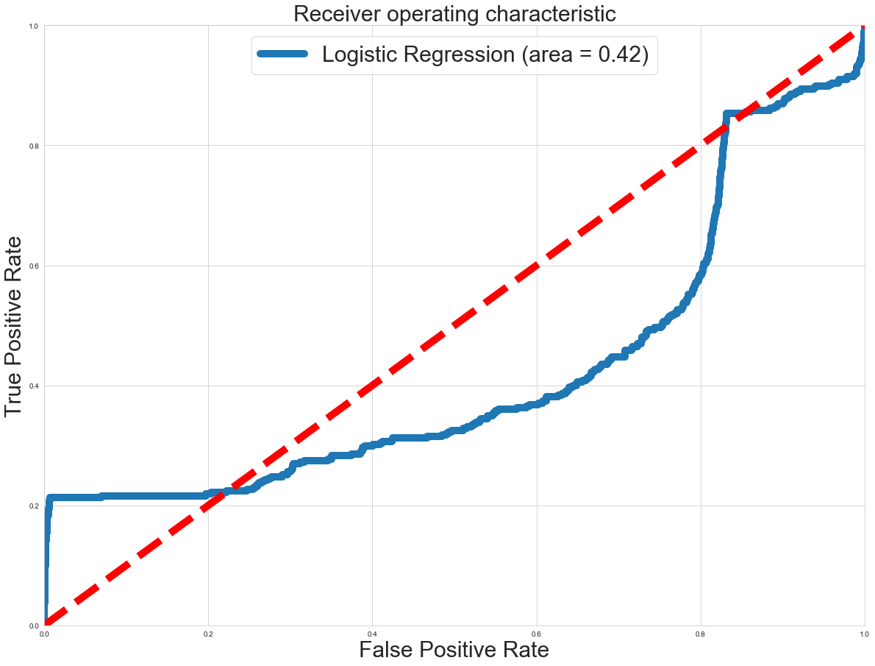
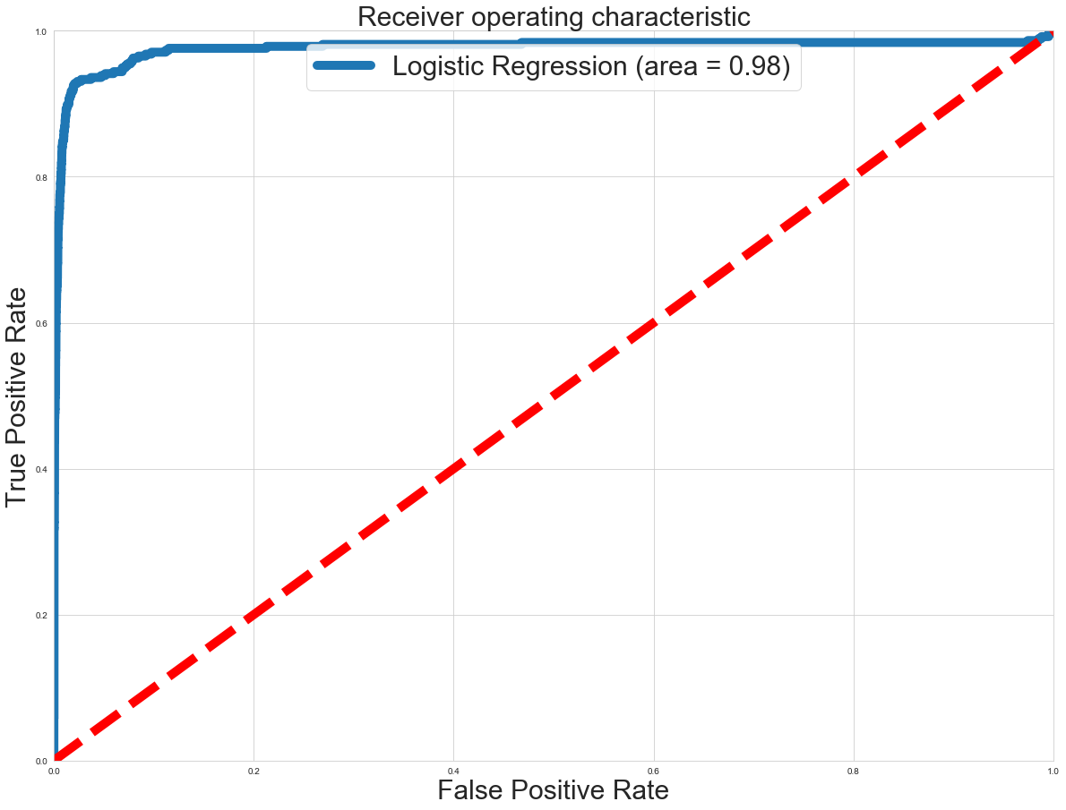
Result Analysis
Moreover, if we compare the ROC_AUC curve of these two approaches, then it’s even more easier to discard the first approach

Slide 21
Result Analysis

Slide 22
Summary and Conclusion
So, throughout the observation of Result analysis, it is observed that the best outcome actually was possible to get from the Approach 2, with modified threshold which is 0.253. With these settings we got the cost of 47860 which is our final score.
Our main target was to minimize this cost as much as we can. But with this logistic regression model, this is the best minimization we can arrive.
Our expected result can be something around 15000~20000. So in that sense, there is a gap of ~27000, which is possible to gain using some more advanced algorithms such as Random forest or Support Vector Machine.
So in the conclusion, it can be said that, the result with logistic regression is decent, but there is a room for more optimization

